Slide 1

PROJECT PROTOTYPE
TEAM - ONBOARDING APP
ARUN, GABON, RON, RUPESH, SRIDEVI, TAYLOR

Slide 2
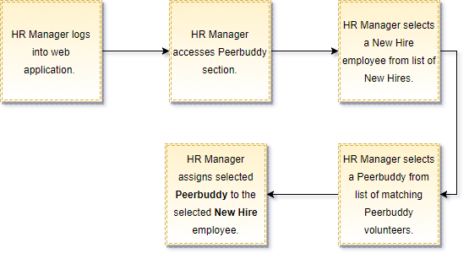
HR-Manager User Flow

Slide 3
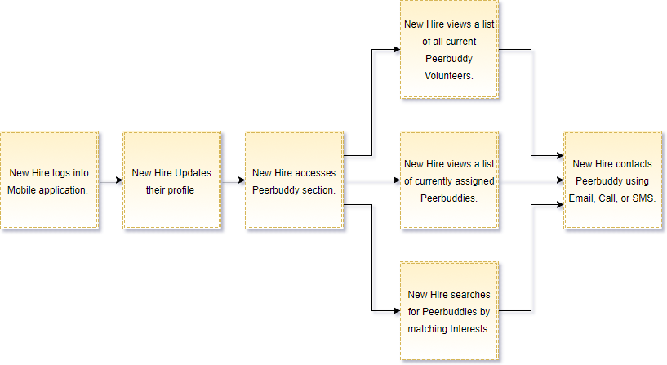
New-Hire User Flow

Slide 4
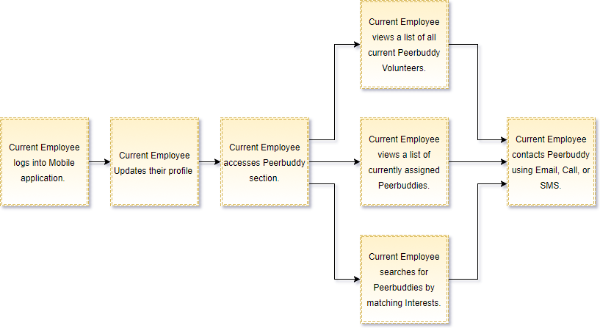
Current-Employee User Flow

Slide 5
GITHUB LINKS
BACKEND : https://github.com/fzachariah/Continental-BackendNodejs
ANDROID: https://github.com/fzachariah/Continental-Android
WEB APP: https://github.com/naveenkanumoori/ContiDashBoard/tree/PeerBuddy_New

Slide 6

Questions?

